Slide 1


HARDWARE.astronomy
Housekeeping Box
(H.aHk Box)
Adam Stammer
Under the Direction of Dr. Carl Ferkinhoff

Slide 2
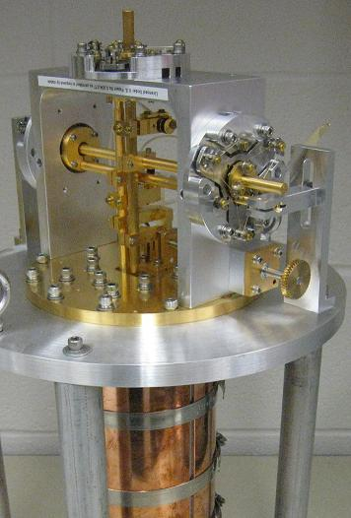
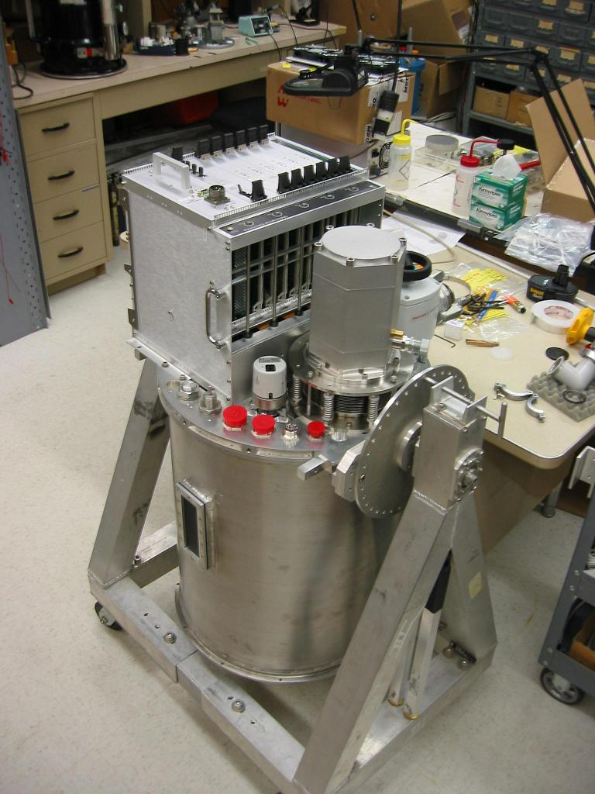
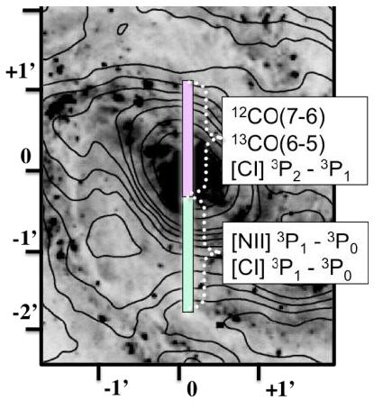
Designed by Dr. Carl Ferkinhoff (~2009)
Radio Telescope
Sub-millimeter grating spectrometer
Observer emission lines in all sub-millimeter
  bands accessible from the ground
Motivations

Slide 3
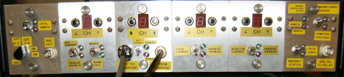
Motivations
Proprietary Design/Obsolete Internal Chips
Multiplexer Readout Rate Limit
Dependent On External PC

Slide 4
Abstract Goals
Open Source
Versatile
Cheap
Modular
Design Steps
Prototyping Daughtercard (P-Card)
Backplane
H.aHKOS Software
Chassis and Accompanying Components
ZEUS2 Daughtercards
Goals

Slide 5
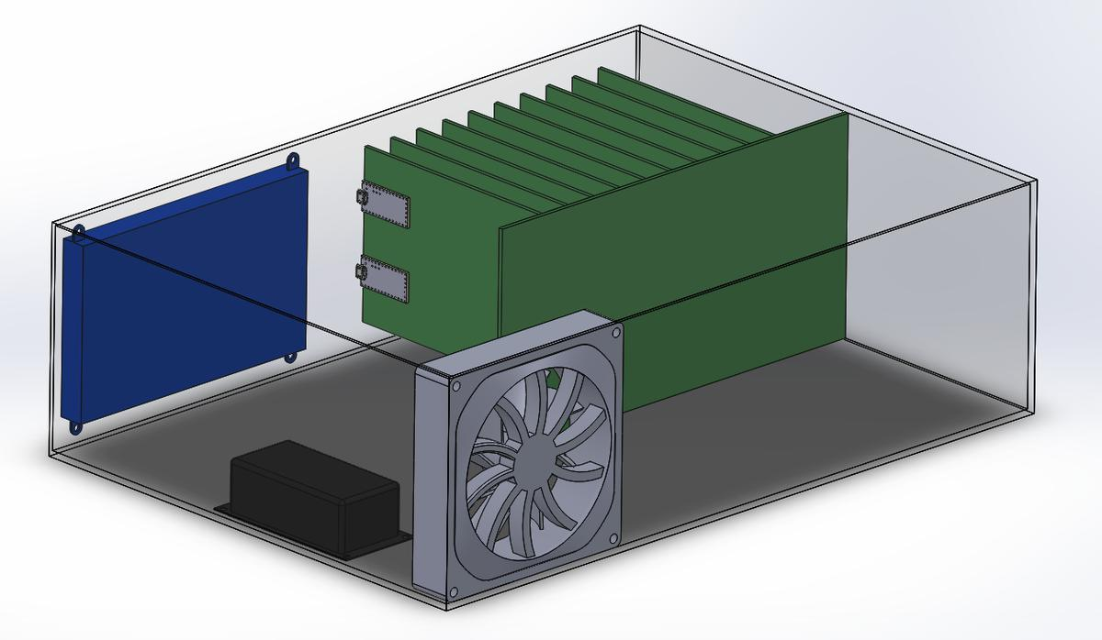
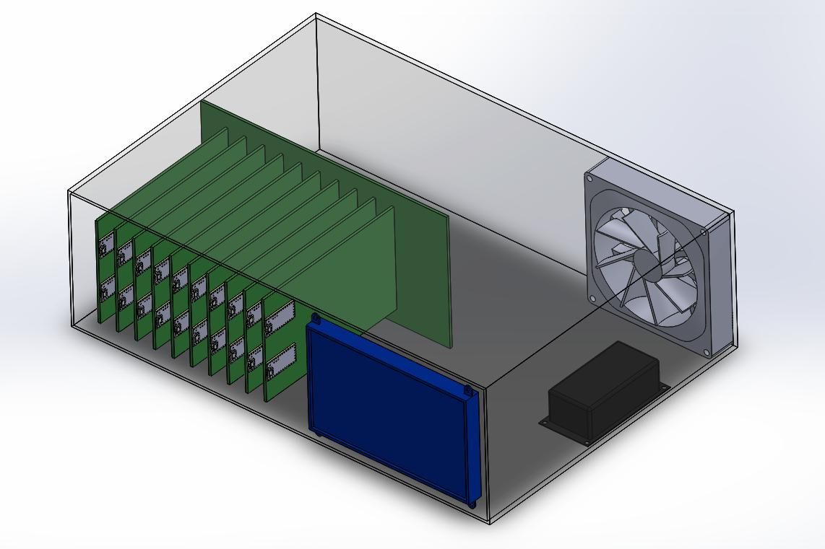
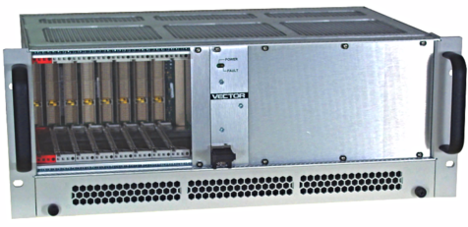
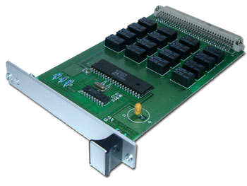
Draft Render and Similar Products
Touch Screen
Backplane & Daughtercards
Cooling Fan
Power Supply

Slide 6

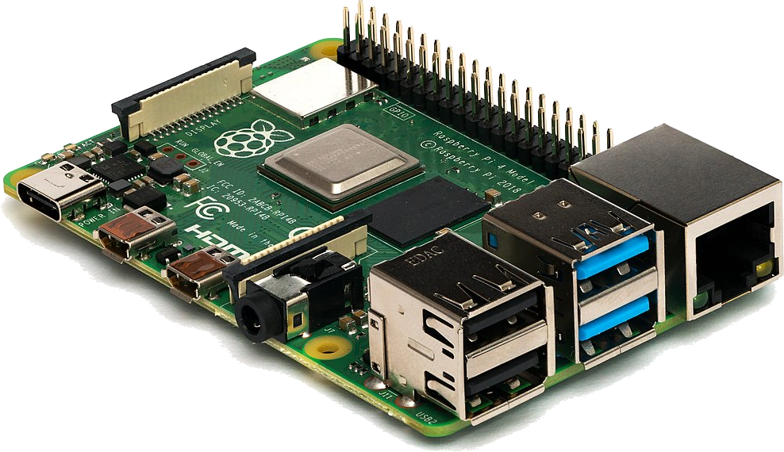

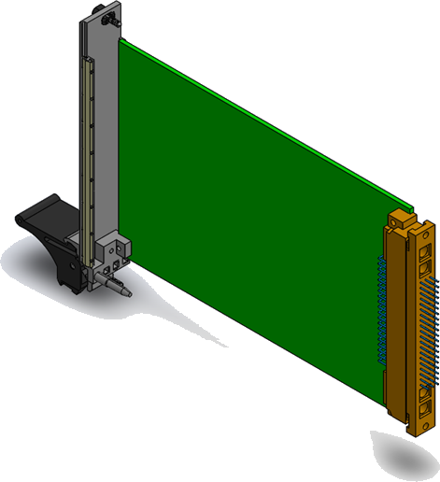

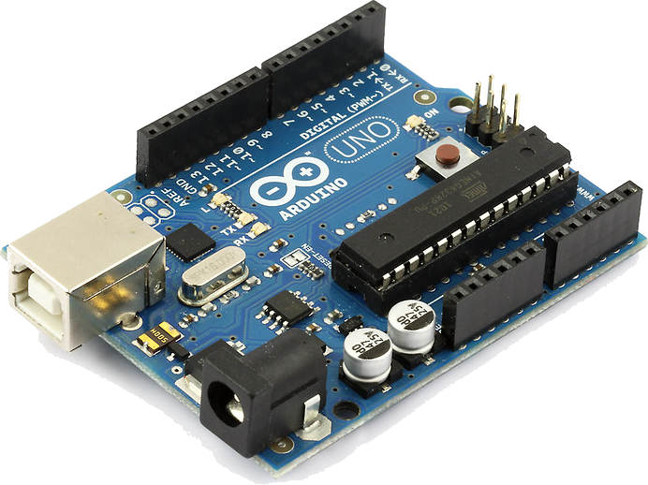
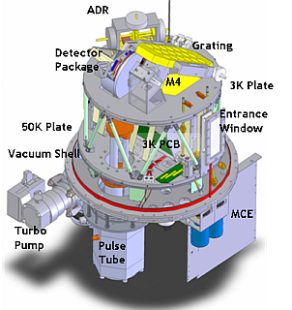

Touchscreen
Raspberry Pi
Microcontrollers
Communication Example
-200°C
Cooler Controller
ZEUS2
Arduino
Temperature Sensor

Slide 7
Touchscreen
Raspberry Pi
Microcontrollers
Communication Example
-200°C
Cooler Controller
ZEUS2
Arduino
Temperature Sensor

Slide 8
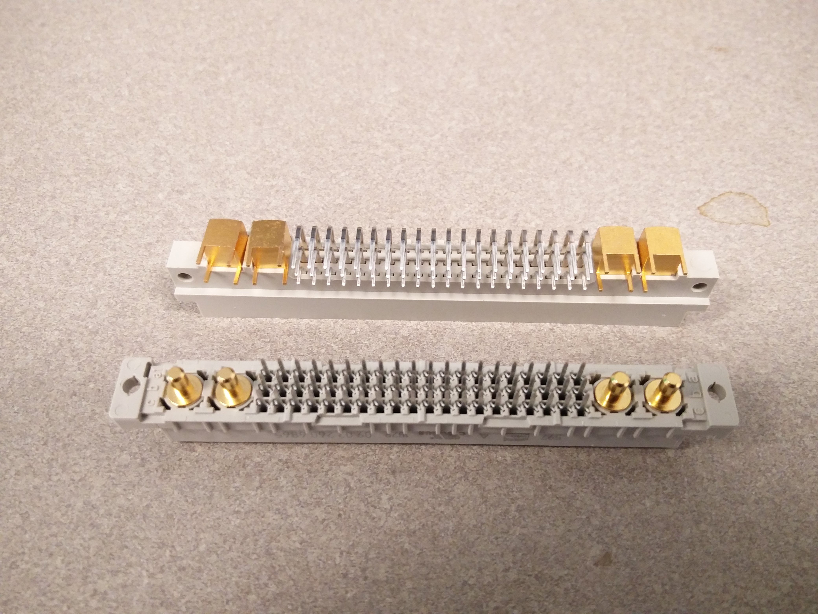
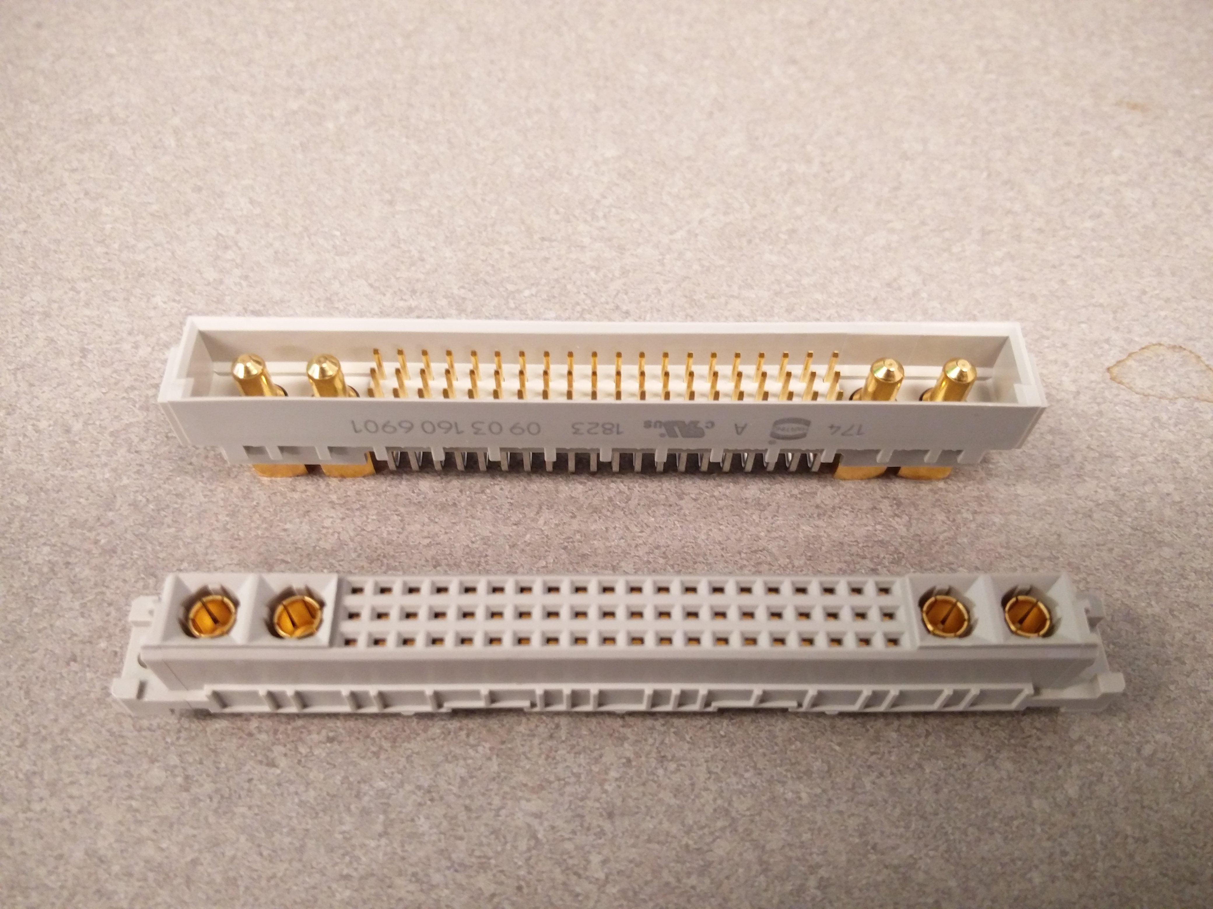
60 Pins @ 2 Amps and 4 High Current Pins @ 20 Amps
Sockets

Slide 9
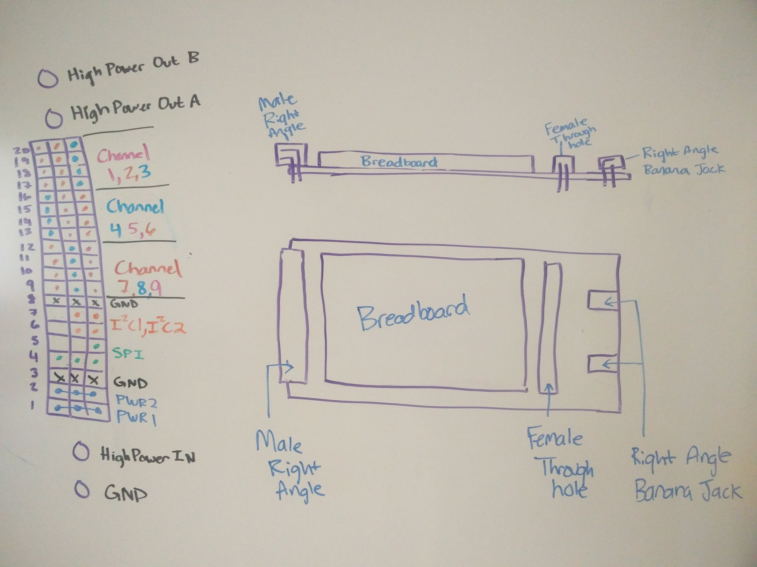
Male Socket, Female Socket, Breadboard, High Power Banana Jacks, Double Length For Easy Access
Prototyping Card (P-Card)
Sketch

Slide 10
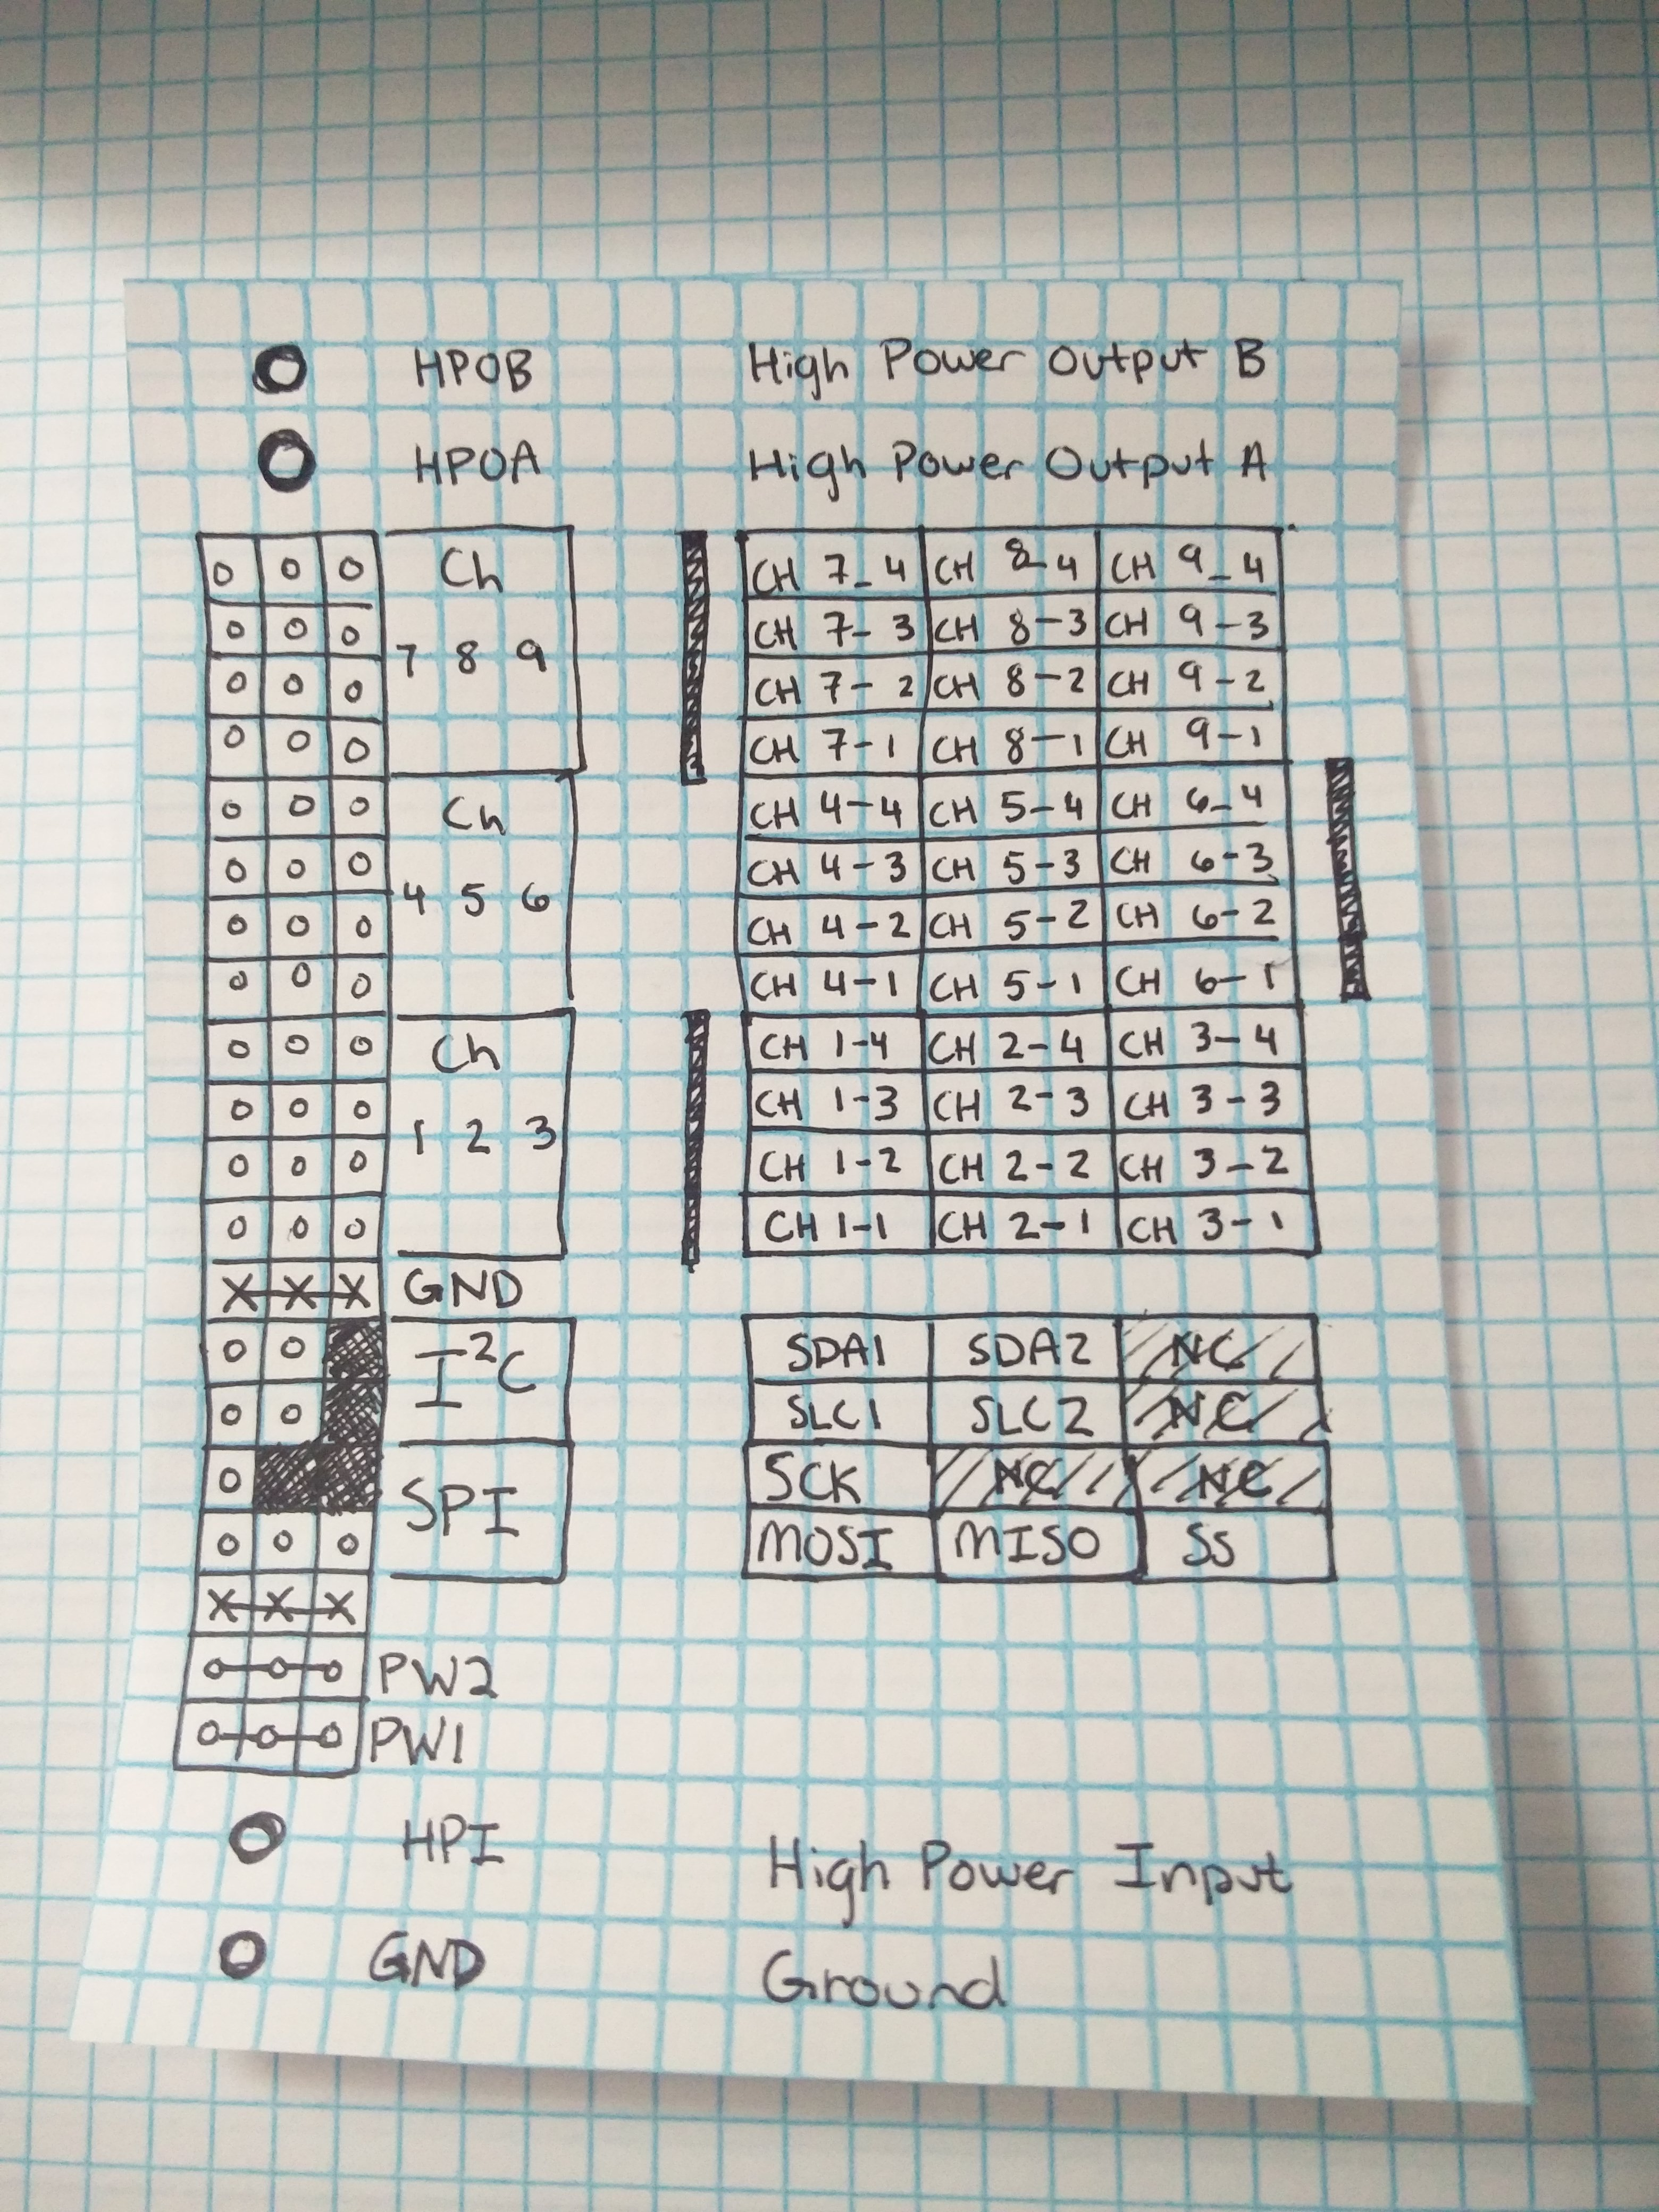
2 HP IO, 9 4pin IO Channels, 2 I2C Channels, 1 SPI Channel, Low Power Input, High Power Input, Ground
Socket Pinout

Slide 11
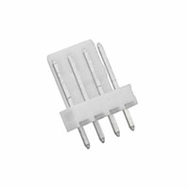
Male Socket, Female Socket, Breadboard, High Power Banana Jacks, Double Length For Easy Access
Prototyping Card (P-Card)
Sketch

Slide 12
Male Socket, Female Socket, Breadboard, High Power Banana Jacks, Double Length For Easy Access
Prototyping Card (P-Card)
Sketch
High Power IO
4-pin IO Channels
x9
External Connections/Standalone
Communications
2 I2C Channels
Parallel SPI
Interrupts
Low Power Input
High Power Input

Slide 13
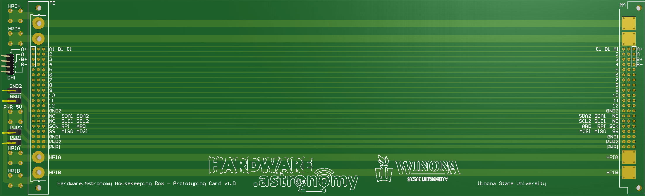
IO Channel
Sockets
High Power IO
High Power Input
Space For
Solderless Breadboard(s)
Low Power Jumpers
P-Card PCB

Slide 14
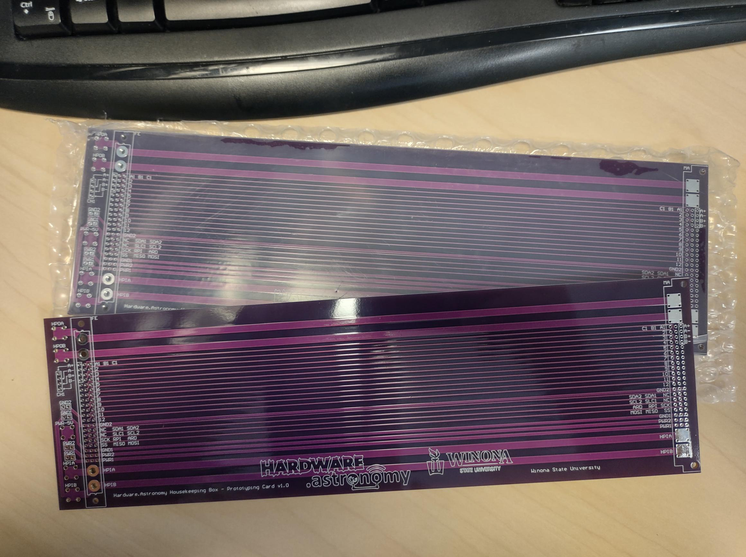

Slide 15
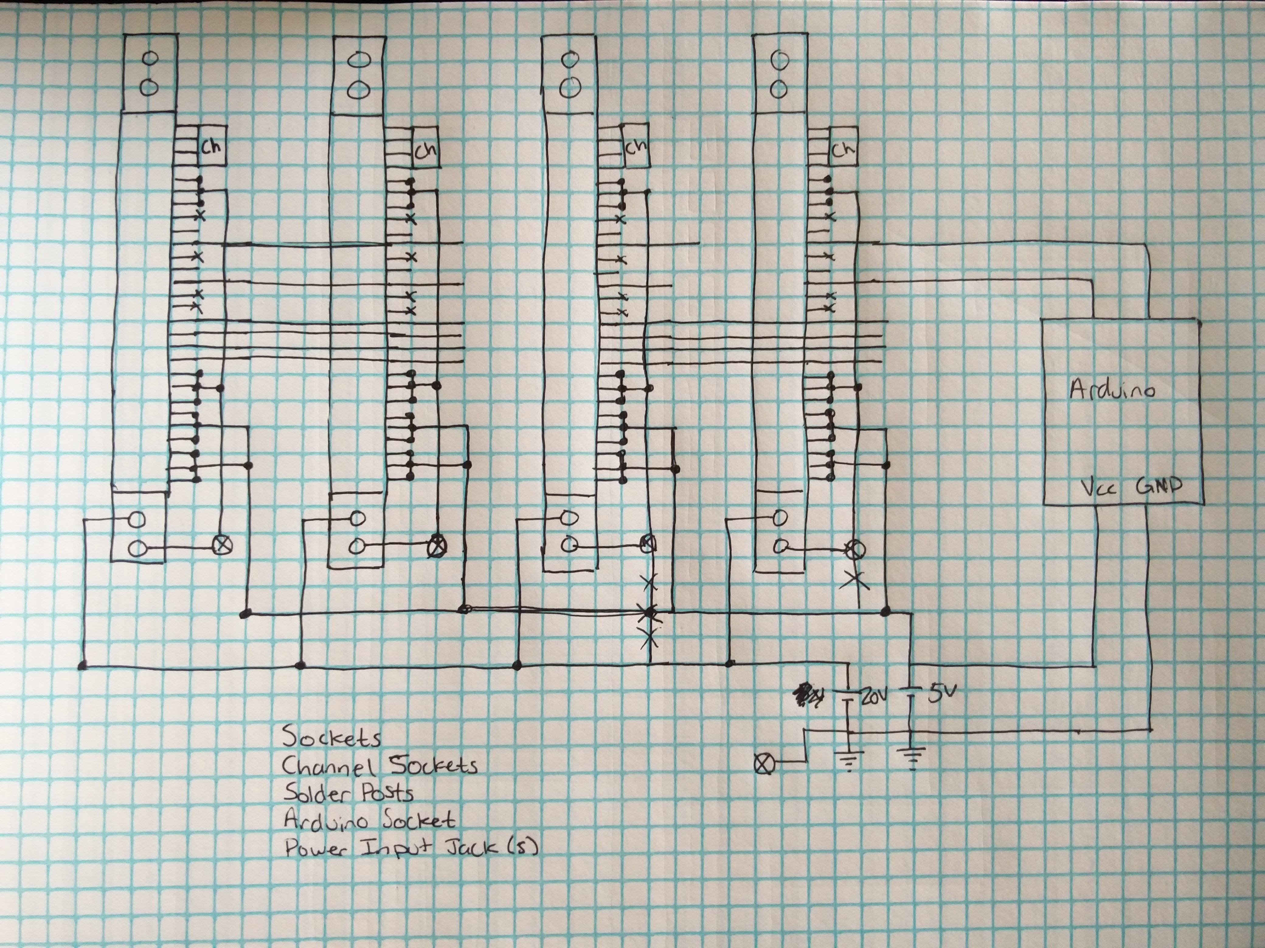
Backplane
Schematic

Slide 16
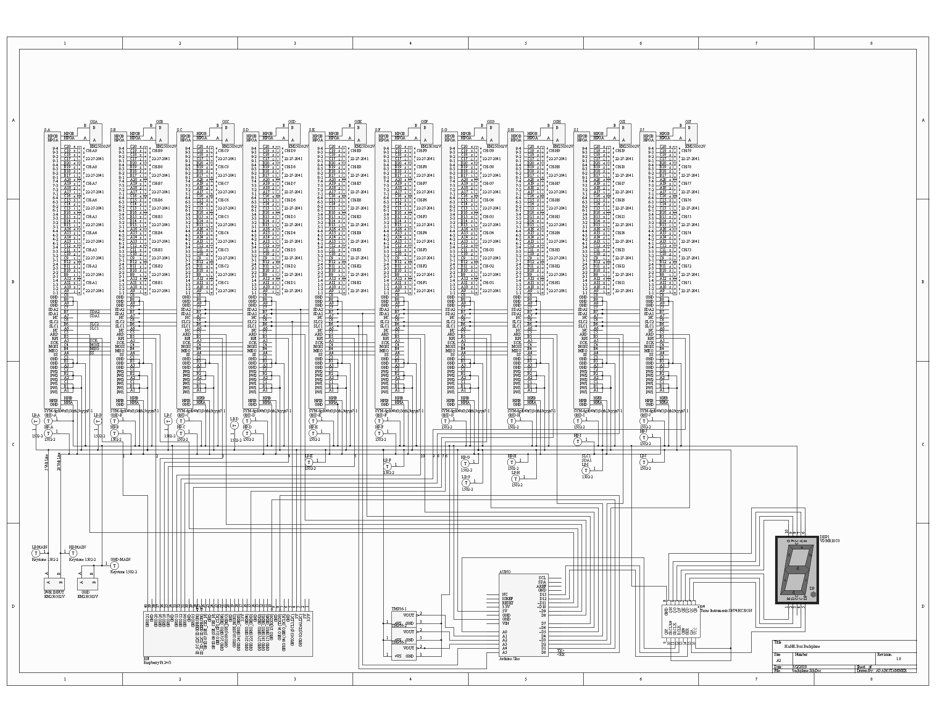
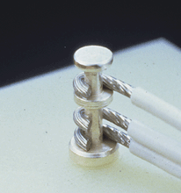
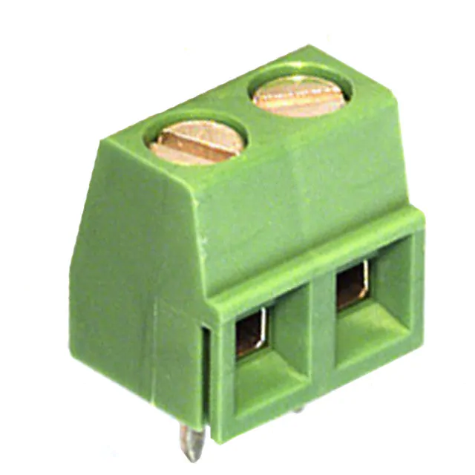
Backplane
Schematic

Slide 17
High Power IO
Backplane
Schematic
4-pin IO
Parallel SPI
High Power Turret Terminals
Error Display
Temp Sensors
Power Input
Microcontrollers

Slide 18
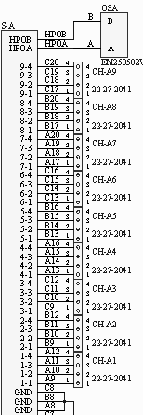
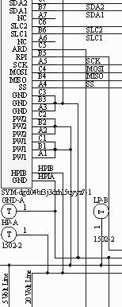
Backplane
Schematic

Slide 19
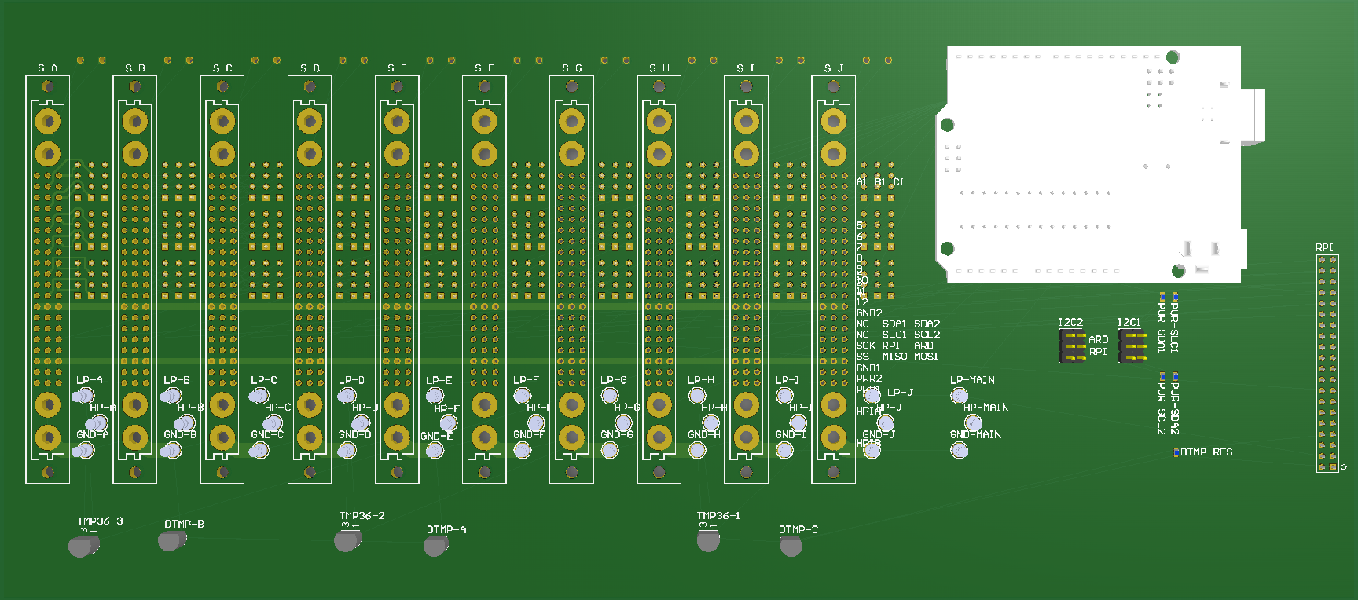
10 Card Sockets
Low Power IO
High Power IO
Arduino Socket
Raspberry Pi Connector
Power Input
Turret Terminals
Temp Sensor

Slide 20
H.aHk OS

Slide 21
On Board Communications
Logistical Header | Source Card Type | [Data Frame 1] | [Data Frame 2] | [Data …] | [Data Frame n]
0 4 8 16 24 n
Logistical Header:
Logistical Request → (0x0) Used to poll slaves for information.
Logistical Response → (0x1) Responds to Logistical Request. Followed by yes/no data frame.
Error → (0x2) Used to report an error.
Data → (0x3) Used to send non-logistical data.
Logistical Request Format
0b0000 | Source Card Type
0 4 8
Logistical Response Format
0b0001 | Source Card Type | (0b0 / 0b1) , Buffer Size
0 4 8 16
Error
0b0010 | Source Card Type | Error Type
0 4 8 16

Slide 22
Finish Backplane PCB Design
Manufacture
Program Controllers
Finish Daughtercard Designs
Next Steps

Slide 23
Questions?

